Slide 1

BATCH NO 16
ST.ANN’S COLLEGE OF ENGINEERING AND TECHONLOGY,CHIRALA
ELECTRICAL AND ELECTRONICS ENGINEERING
CONTROL STRATEGY &
MATHEMATICAL MODELING OF BLDC MOTOR IN
ELECTRIC POWER STEERING
PROJECT ASSOCIATES
P.BALAMURALI KRISHNA (11F05A0217)
S.SYAM KUMAR(10F01A02A2)
M.NIRMALA(10F01A0276)
P.VAMSI KRISHNA(10F01A0291)
UNDER THE GUIDANCE OF
V.PAVANI M.TECH

Slide 2
ABSTARCT
This project briefly describes the composition of electric power steering (EPS) system and the development advantages of brushless DC (BLDC) motor.
A control strategy and mathematical model of the BLDC motor used in EPS System is proposed.

Slide 3
INTRODUCTION
The electrically controlled steering system on passenger car is mostly Electric Hydraulic Power Steering system (EHPS) or Electric Power Steering system (EPS).
Comparing with EHPS, EPS is more environmentally friendly, safer and saves more energy.
The power source of EPS is electric motor, which is the major factor affecting the EPS performance.

Slide 4
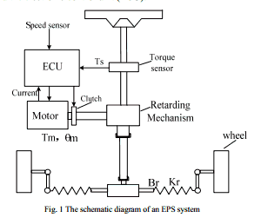
SCHEMATIC DIAGRAM OF AN
EPS SYSTEM

Slide 5
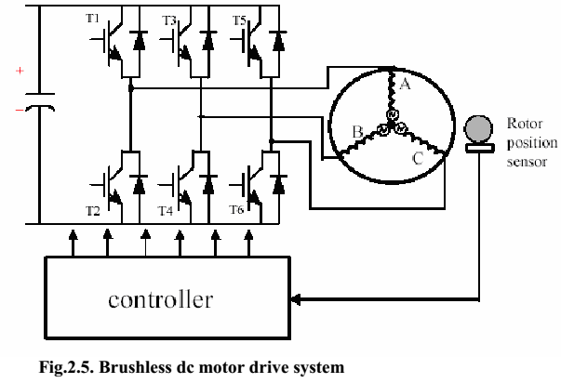
BLDC drives operation with inverter
Basically it is an electronic motor and requires a three-phase inverter in the front end as shown in Fig.
In self control mode the inverter acts like an electronic commutator that receives the switching logical pulse from the absolute position sensors.

Slide 6
PI speed controller design
A proportional integral is control loop feedback mechanism used in industrial control system.
In industrial process a PI controller attempts to correct that error between a measured process variable and desired set point by calculating and then outputting corrective action that can adjust the process accordingly.

Slide 7
Hysteresis current controller
The Hysteresis current controller contributes to the generation of the switching signals for the inverter.
Hysteresis-band PWM is basically an instantaneous feedback current control method of PWM where the actual current continually tracks the command current within hyssteresis-band.

Slide 8
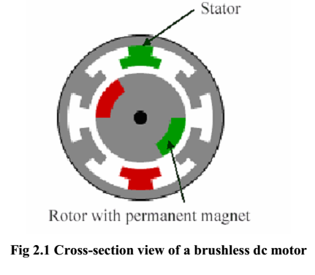
Brushless dc motor background
BLDC motor drives, systems in which a permanent magnet excited synchronous motor is fed with a variable frequency inverter controlled by a shaft position sensor.
A brushless dc motor is a dc motor turned inside out, so that the field is on the rotor and the armature is on the stator.
Instead of commutating the armature current using brushes, electronic commutation is used.

Slide 9
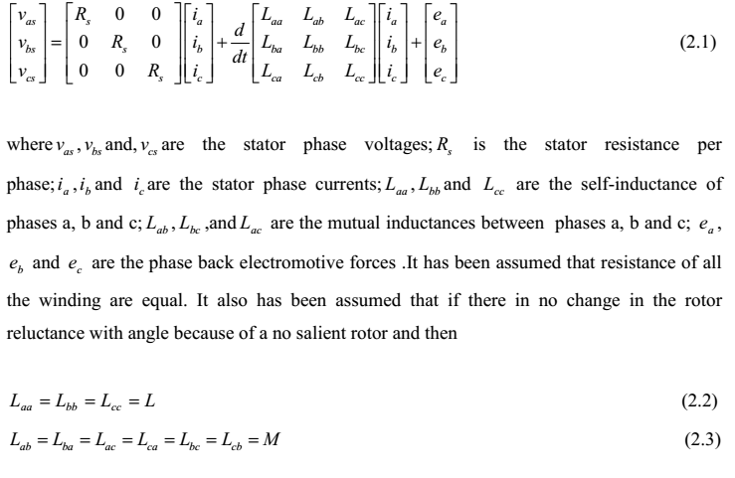
Machine Dynamic Model

Slide 10
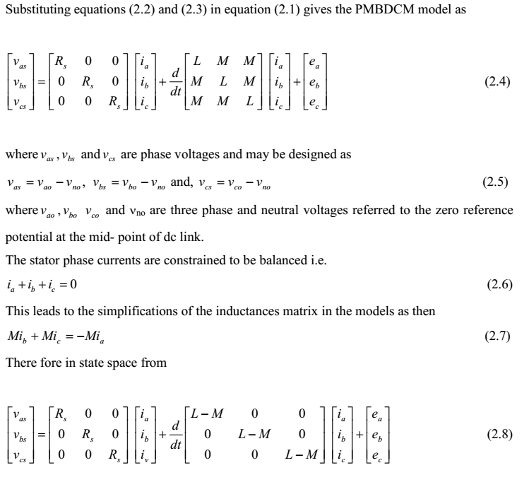

Slide 11
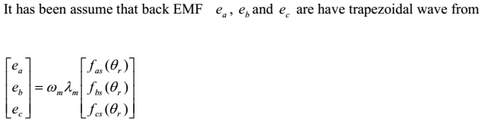
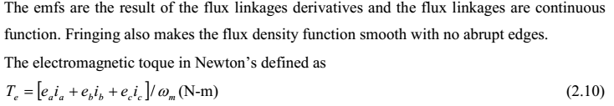

Slide 12
SIMULATION PROGRAM FOR BLDC MOTOR
R=0.7;
Lt=0.00521;
Ke =0.13658;
Kt =0.13658;
J=0.0022;
F=0.1;
Vd =380;
Vf =0.1;
P=4;

Slide 13
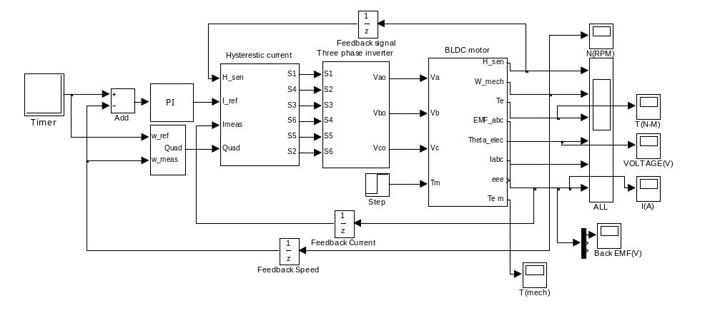
Simulation model of BLDC Motor
The simulation model of BLDC motor

Slide 14
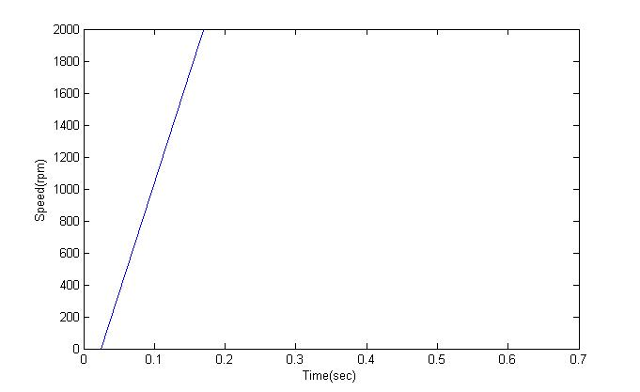
Simulation Results
Speed -Time Characteristics
Notes:
Time(S)

Slide 15
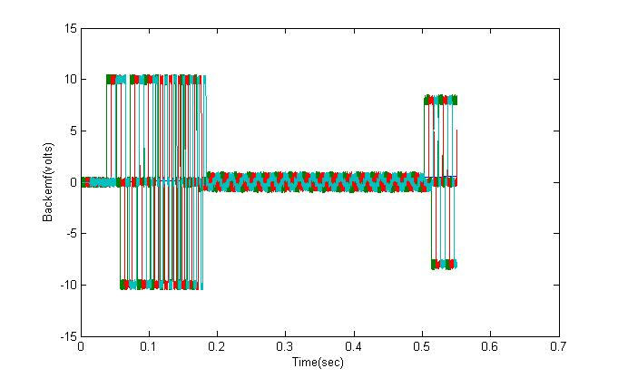
3-phase Back-EMF waveform

Slide 16
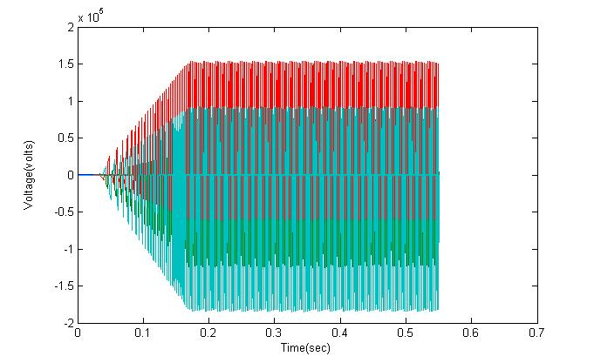
3-phase voltage waveform

Slide 17
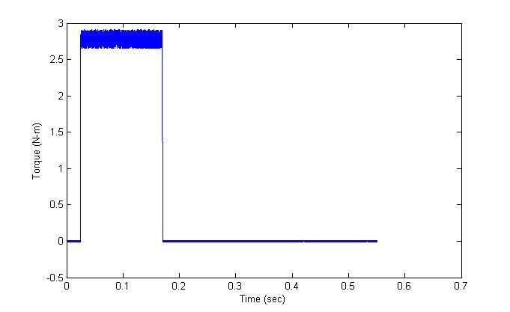
The torque response waveform
Notes:
Time(S)

Slide 18
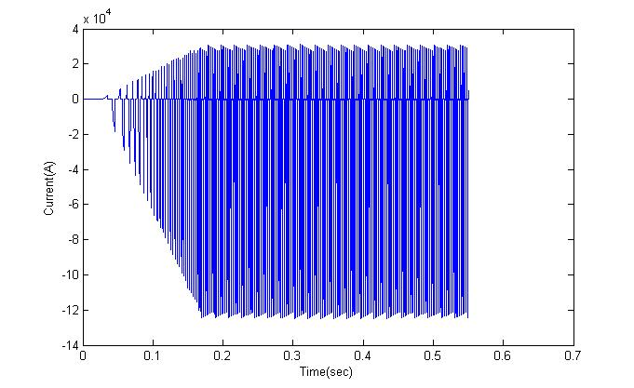
3-phase current waveform

Slide 19
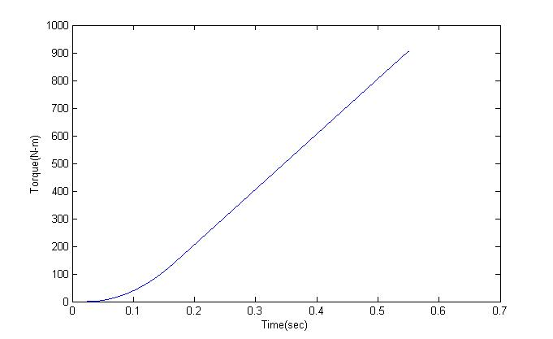
Mechanical Torque Wave form

Slide 20
CONCLUSION
In this project, the model of EPS system based on BLDC is built.
The simulation results show that the control strategy of the BLDC motor is valid.

Slide 21
REFERENCES
[1] Wu Jie, Wang Yun-Yan. A New Technique for Reducing Cogging Torque in EPS Permanent Magnet Brushless Motor[C]. Hubei University of Technology.
[2] Qiu Shao-feng. Study of Permanent Magnet Coreless Brushless DC Motor Control System Used in Electric Power Steering System[D] Huazhong University of Science and Technology

Slide 22
THANK YOU!!!

